Slide 1
CPSC 440
§3.1 Introduction
Chapter 3: Arithmetic for Computers (part 1)*
* This ppt is provided by the publisher of the textbook
Notes:
Morgan Kaufmann Publishers
Chapter 3 — Arithmetic for Computers

Slide 2
Arithmetic for Computers
§3.1 Introduction
Operations on integers
  Addition and subtraction
  Multiplication and division
  Dealing with overflow
Floating-point real numbers
  Representation and operations
Chapter 3 — Arithmetic for Computers — <number>
Notes:
Morgan Kaufmann Publishers
Chapter 3 — Arithmetic for Computers

Slide 3

Integer Addition
Example: 7 + 6
§3.2 Addition and Subtraction
Overflow if result out of range
Chapter 3 — Arithmetic for Computers — <number>
Notes:
Morgan Kaufmann Publishers
Chapter 3 — Arithmetic for Computers

Slide 4
Integer Subtraction
Add negation of second operand
Example: 7 – 6 = 7 + (–6)
  +7: 0000 0000 … 0000 0111
  –6: 1111 1111 … 1111 1010
  +1: 0000 0000 … 0000 0001
Overflow if result out of range
Chapter 3 — Arithmetic for Computers — <number>
Notes:
Morgan Kaufmann Publishers
Chapter 3 — Arithmetic for Computers

Slide 5
Dealing with Overflow
Some languages (e.g., C) ignore overflow
  Use MIPS addu, addui, subu instructions
Other languages (e.g., Ada, Fortran) require raising an exception
  Use MIPS add, addi, sub instructions
  On overflow, invoke exception handler
    Save PC in exception program counter (EPC) register
    Jump to predefined handler address
    mfc0 (move from coprocessor reg) instruction can retrieve EPC value, to return after corrective action
Chapter 3 — Arithmetic for Computers — <number>
Notes:
Morgan Kaufmann Publishers
Chapter 3 — Arithmetic for Computers

Slide 6

Multiplication
§3.3 Multiplication
Start with long-multiplication approach
multiplicand
1000
× 1001
1000
0000
0000
1000
1001000
multiplier
product
Length of product is the sum of operand lengths
Chapter 3 — Arithmetic for Computers — <number>
Notes:
Morgan Kaufmann Publishers
Chapter 3 — Arithmetic for Computers

Slide 7

Multiplication Hardware
Initially 0
Chapter 3 — Arithmetic for Computers — <number>
Notes:
Morgan Kaufmann Publishers
Chapter 3 — Arithmetic for Computers

Slide 8

Optimized Multiplier
Perform steps in parallel: add/shift
One cycle per partial-product addition
  That’s ok, if frequency of multiplications is low
Chapter 3 — Arithmetic for Computers — <number>
Notes:
Morgan Kaufmann Publishers
Chapter 3 — Arithmetic for Computers

Slide 9
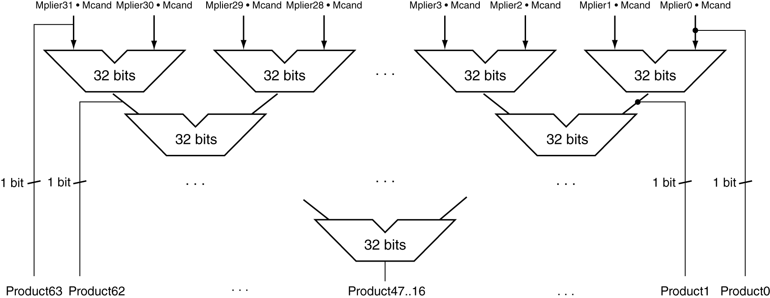
Faster Multiplier
Uses multiple adders
  Cost/performance tradeoff
Can be pipelined
  Several multiplication performed in parallel
Chapter 3 — Arithmetic for Computers — <number>
Notes:
Morgan Kaufmann Publishers
Chapter 3 — Arithmetic for Computers

Slide 10
Division
§3.4 Division
Check for 0 divisor
Long division approach
  If divisor ≤ dividend bits
    1 bit in quotient, subtract
  Otherwise
    0 bit in quotient, bring down next dividend bit
Restoring division
  Do the subtract, and if remainder goes < 0, add divisor back
Signed division
  Divide using absolute values
  Adjust sign of quotient and remainder as required
quotient
dividend
1001
1000 1001010
-1000
10
101
1010
-1000
10
divisor
remainder
n-bit operands yield n-bit
quotient and remainder
Chapter 3 — Arithmetic for Computers — <number>
Notes:
Morgan Kaufmann Publishers
Chapter 3 — Arithmetic for Computers

Slide 11


Division Hardware
Initially divisor in left half
Initially dividend
Chapter 3 — Arithmetic for Computers — <number>
Notes:
Morgan Kaufmann Publishers
Chapter 3 — Arithmetic for Computers

Slide 12

Optimized Divider
One cycle per partial-remainder subtraction
Looks a lot like a multiplier!
  Same hardware can be used for both
Chapter 3 — Arithmetic for Computers — <number>
Notes:
Morgan Kaufmann Publishers
Chapter 3 — Arithmetic for Computers

Slide 13
Faster Division
Can’t use parallel hardware as in multiplier
  Subtraction is conditional on sign of remainder
Faster dividers (e.g. SRT devision) generate multiple quotient bits per step
  Still require multiple steps
Chapter 3 — Arithmetic for Computers — <number>
Notes:
Morgan Kaufmann Publishers
Chapter 3 — Arithmetic for Computers

